Slide 1
Microcontrollers
Tom Rethard

Slide 2
Impact
“In the aggregate, PC microprocessors are responsible for less than 1% of all processors sold. Embedded processors outsell PC processors by more than 99%.” [Microcontrollers.com]

Slide 3
Examples
Personal information products: Cell phone, pager, watch, pocket recorder, calculator
Laptop components: mouse, keyboard, modem, fax card, sound card, battery charger
Home appliances: door lock, alarm clock, thermostat, air conditioner, tv remote, hair dryer, VCR, small refrigerator, exercise equipment, washer/dryer, microwave oven
Toys; video games, cars, dolls, etc.

Slide 4
Microcontroller Families
Most manufacturers offer a wide range of devices for low end to higher end applications
“In January 2000, Microchip shipped its one billionth 8-bit PIC microcontroller.” [Microcontroller.com]
Notes:
Motorola claims 5 billion 68hc05s:
MUNICH, GERMANY AND AUSTIN, TEXAS (USA) -October 15, 2001 - The world's leading supplier of microcontrollers, Motorola, Inc. (NYSE: MOT), today announced that it has shipped its first five billion 68HC05 8-bit microcontrollers. This is a significant milestone in that Motorola is the only microcontroller manufacturer to date to have shipped such large quantities of a single product line. 68HC05 microcontrollers (MCUs) provide the DigitalDNA( intelligence behind safety enhancement, convenience and other features for thousands of end products including appliances, automobiles, computer peripherals, exercise equipment, telephones, toys, and smartcards.

Slide 5
Microcontrollers
Processing power: 4 bit, 8 bit, 16 bit, 32 bit
Microcontrollers.com: “The highest rate of new product success is in the 8-bit microcontroller market. The lowest rate of success is in the 64- and 32-bit microcontroller markets.”
Specific features: communications, keyboard handling, signal processing, video processing
Notes:
Low end microcontrollers:
8051, motorola 68HC05
HARVARD architecture-> SEPARATE busses for instructions and data→ PIPELINING

Slide 6
Microcontroller Market
Shipments- > 16 Billion in 2000, 8 bit > 1/2 market
Major Players
  Microchip 16Fxx
  Intel 8051
  Motorola MC68HC05
  National COP800
  SGS/Thomson ST62
  Zilog Z86Cxx
Notes:
Russ Hersch FAQs: generally OLD!!
Von-Neuman Architecure Microcontrollers based on the Von-Neuman architecture have a single "data" bus that is used to fetch both instructions and data. Program instructions and data are stored in a common main memory. When such a controller addresses main memory, it first fetches an instruction, and then it fetches the data to support the instruction. The two separate fetchs slow the controllers operation. Harvard Architecture Microcontrollers based on the Harvard Architecture have a separate data bus and an instruction bus. This allows execution to occur in parallel. As an instruction is being "pre-fetched", the current instruction is executing on the data bus. Once the current instruction is complete, the next instruction is ready to go. This pre-fetch theoretically allows for much faster execution than a Von-Neuman architecture, but there is some added silicon complexity.
COP800 Family (National Semiconductor) The COP800 Basic Family is a fully static 8-bit microcontroller, fabricated using double metal silicon gate microCMOS technology. This low cost microcontroller contains all system timing, interrupt logic, ROM, RAM, and I/O necessary to implement dedicated control functions in a variety of applications. Depending on the device, features include: 8-bit memory mapped architect, MICROWIRE serial I/O, UART, memory mapped I/O, many 16 bit timer/counters with capture registers, a multi-sourced vectored interrupt, comparator, WATCHDOG Timer and Clock monitor, Modulator/Timer (high speed PWM timer for IR transmission), 8-channel A/D converter with prescaler and both differential and single-ended modes, brownout protection, halt mode, idle mode, high current I/O pins with 15mA sink capability, Schmitt trigger inputs and Multi-Input-Wake-Up. Most devices operate over a voltage range from 2.5V to 6V. High throughput is achieved with an efficient, powerful instruction set operating at a 1uS per instruction rate (most instructions are single byte/single cycle) including true bit manipulation and BCD arithmetic instructions. Most devices have military versions for -55C to +125C.
PIC (MicroChip) While watching my 8 year old daughter play with her Barbie Dolls (she has about 7 or so, including two that used to belong to Roz, my wife, when she was a girl) I noticed an interesting difference between the old dolls and the new dolls. The old Barbies could only move their heads sideways, while the new Barbies not only can move their heads sideways, but also up and down. AMAZING - the old Barbies were good girls - they could only say no. The new Barbies however can also say yes. Progress - isn't it wonderful! (Not to mention the gymnast Barbie that Dave Perry's daughter got for Christmas - "wait'll you see what *she* can do ;-)" Which leads me to an amazing fact. Most everyone thinks of the PIC microcontroller line as being a recent introduction. However, they've been popular for over 20 years. What's the difference? Microchip (which was originally [owned by] General Instruments), seems to have recreated this microcontroller into a product universally regarded as a powerful and cost effective solution. The new chips are fabricated in CMOS, some features have been added, and new family lines have been introduced. The PIC microcontrollers were the first RISC microcontrollers. RISC generally implies that simplicity of design allows more features to be added at lower cost, and the PIC line is no exception. Although having few instructions (eg. 33 instructions for the 16C5X line versus over 90 for the Intel 8048), the PIC line has a wealth of features included as part of the chip. Separate buses for instructions and data (Harvard architecture) allows simultaneous access of program and data, and overlapping of some operations for increased processing performance. The benefits of design simplicity are a very small chip, small pin count, and very low power consumption. PIC microcontrollers are rapidly gaining in popularity. They are being featured more and more often in construction projects in popular hobbyist magazines, and are chalking up a good number of design wins. Due to their low cost, small size, and low power consumption, these microcontrollers can now be used in areas that previously wouldn't have been appropriate (such as logic circuits). They are currently available in three lines: the PIC16C5x, PIC16Cxx, and PIC17Cxx families.

Slide 7
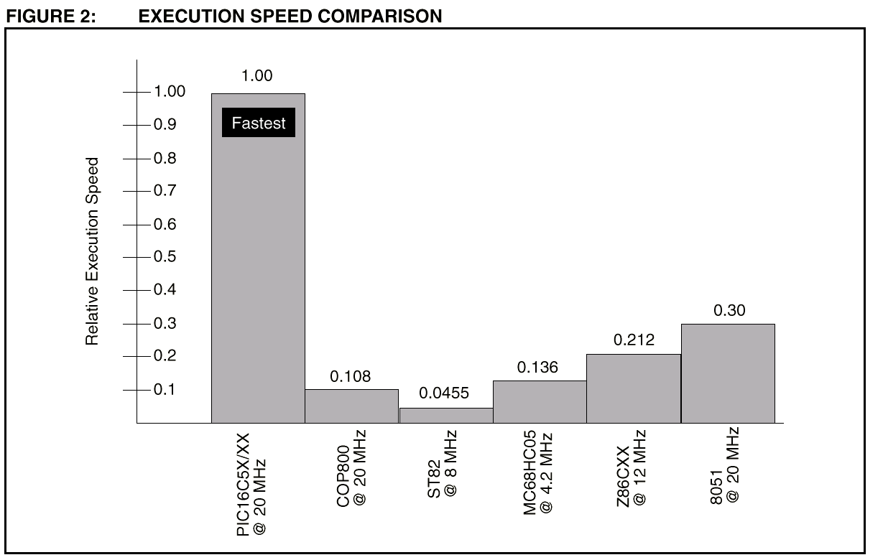
Speed comparison
From: Mark Palmer, AN520 A Comparison of 8 bit
Microcontrollers, Microchip AN, 1995.
Notes:
Based on 4 typical tasks; packing BCD, loop control, bit test and branch, serial data xmit…
2 factors; Harvard architecture; 14 bit instruction bus hold 8 bit operand….code is also a lot simpler, almost all instructions
Execute in ONE cycle. RISC -> 33 instructions [half that of comparable uCs.]

Slide 8
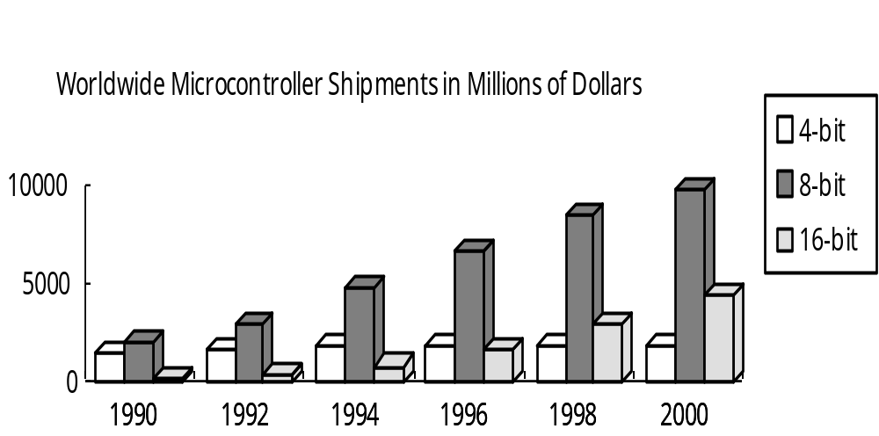
Shipments

Slide 9
What is a Microcontroller?
A microcontroller is a computer:
  CPU
  RAM/ROM
  I/O

Slide 10
So What’s Different?
Microcontrollers are "special purpose computers."
  Embedded inside some other device
    Also called “embedded controller”
  Dedicated to one task/run one specific program.
  Often low-power
  Dedicated I/O device
  A microcontroller is often small and low cost.
  Low-end 1K bytes of ROM and 20 bytes of RAM on the chip, along with eight I/0 pins.

Slide 11
Basic Stamp Family
From Parallax.
PIC microcontroller customized to understand BASIC.
Can be purchased on a small carrier board that accepts a 9-volt battery
Program it by plugging it into one of the ports on a PC
Commonly used for prototyping or for one-off demo products because of ease of set up and use.

Slide 12
Why “Stamp”?
They are about as big as a postage stamp.
Two versions of the BASIC Stamp
  BS-1 and the BS-2.

Slide 13
BS-1
RAM: 14 bytes
EEPROM: 256 bytes
Max program length: about 75 instructions
Execution speed: 2,000 lines/sec
I/O pins: 8

Slide 14
BS-2
RAM: 26 bytes
EEPROM: 2 kilobytes
Max program length: about 600 instructions
Execution speed: 4,000 lines/sec
I/O pins: 16

Slide 15
Programming Language
for...next - normal looping statement
gosub - go to a subroutine
goto - goto a label in the program (e.g. - "label:")
if...then - normal if/then decision
let - assignment (optional)
return - return from a subroutine
end - end the program and sleep

Slide 16
Programming Language
I/O Instructions
  button - read a button on an input pin, with debounce and auto-repeat
  high - set an I/O pin high
  input - set the direction of an I/O pin to input
  low - set an I/O pin low
  output - set the direction of an I/O pin to output
  pot - read a potentiometer on an I/O pin
  pulsin - read the duration of a pulse coming in on an input pin

Slide 17
Programming Language
I/O Instructions
  pulsout - send a pulse of a specific duration out on an output pin
  pwm - perform pulse width modulation on an output pin
  reverse - reverse the direction of an I/O pin
  serin - read serial data on an input pin
  serout - write serial data on an output pin
  sound - send a sound of a specific frequency to an output pin
  toggle - toggle the bit on an output pin

Slide 18
Programming Language
Specific to Basic Stamp
  branch - read a branching table
  debug - send a debugging string to the console
  eeprom - download a program to EEPROM
  lookdown - return the index of a value in a list
  lookup - array lookup using an index
  nap - sleep for a short time
  pause - delay for the specified time
  random - pick a random number
  read - read a value from EEPROM
  sleep - power down for the specified time
  write - write data to EEPROM

Slide 19
Programming Language
Operations
  + - addition
  - - subtraction
  * - multiplication (low-word)
  ** - multiplication (high-word)
  / - division
  // - mod
  max - return maximum of 2 values
  min - return minimum of 2 values

Slide 20
Programming Language
More Operations
  & - AND
  | - OR
  ^ - XOR
  &/ - NAND
  |/ - NOR
  ^/ - XNOR

Slide 21
Programming Language
If statement logic:
  =
  <>
  <
  <=
  >
  >=
  AND
  OR

Slide 22
Variables (BS-1 Example)
Variables have pre-defined names (which you can substitute with names of your own):
  w0, w1, w2...w6 - 16-bit word variables
  b0, b1, b2...b13 - 8-bit byte variables
  bit0, bit1, bit2...bit15 - 1-bit bit variables
Because there are only 14 bytes of memory, w0 and b0/b1 are the same locations in RAM, and w1 and b2/b3 are the same, and so on. Also, bit0 through bit15 reside in w0 (and therefore b0/b1 as well).

Slide 23
I/O pins
14 of the instructions have to do with the I/O pins.
  8ght pins on the BS-1 (numbered 0 to 7)
  16 pins on the BS-2 (numbered 0 to 15).
Bi-directional
Simple output:
  high 3 sends a 1 (+5 volts) out on pin 3.
  low 3 sends a 0 (Ground)

Slide 24
Other I/O
POT: reads the setting on a potentiometer if it’s wired with with a capacitor as the POT instruction expects
PWM: sends out pulse-width modulated signals.

Slide 25
Stamp Start Kit
The Stamp
A programming cable
An application that you run on your desktop computer to download BASIC programs into the Stamp.

Slide 26
Running a program
Write the program first!
Hit ALT-R
  The editor application checks the BASIC program and then sends it down the wire to the EEPROM on the Stamp.
The Stamp then executes the program.

Slide 27
The PIC Family

Slide 28
What is it?
Product of the Microchip Technology.
Microchip produces microcontrollers, special memory chips, and other products.
Dozens of variations of PIC chip if the family
Most of them are single chip operation
Available in One Time Programmable (OTP) packages
Common instruction set and architecture across the family.

Slide 29
Architecture
Two interesting architecture decisions
  RISC instruction set
  Harvard architecture.
RISC = Reduced Instruction Set Computer
  Instruction set small
  Useful set of instructions typically executed in a single clock
  Simplifies pipelining
Harvard architecture
  Program memory and data memory
  Memory banks on separate busses
  Permits cleaner pipelining

Slide 30
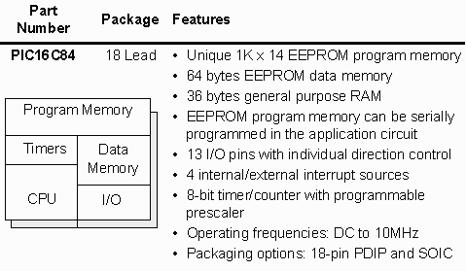
A Guided Tour

Slide 31
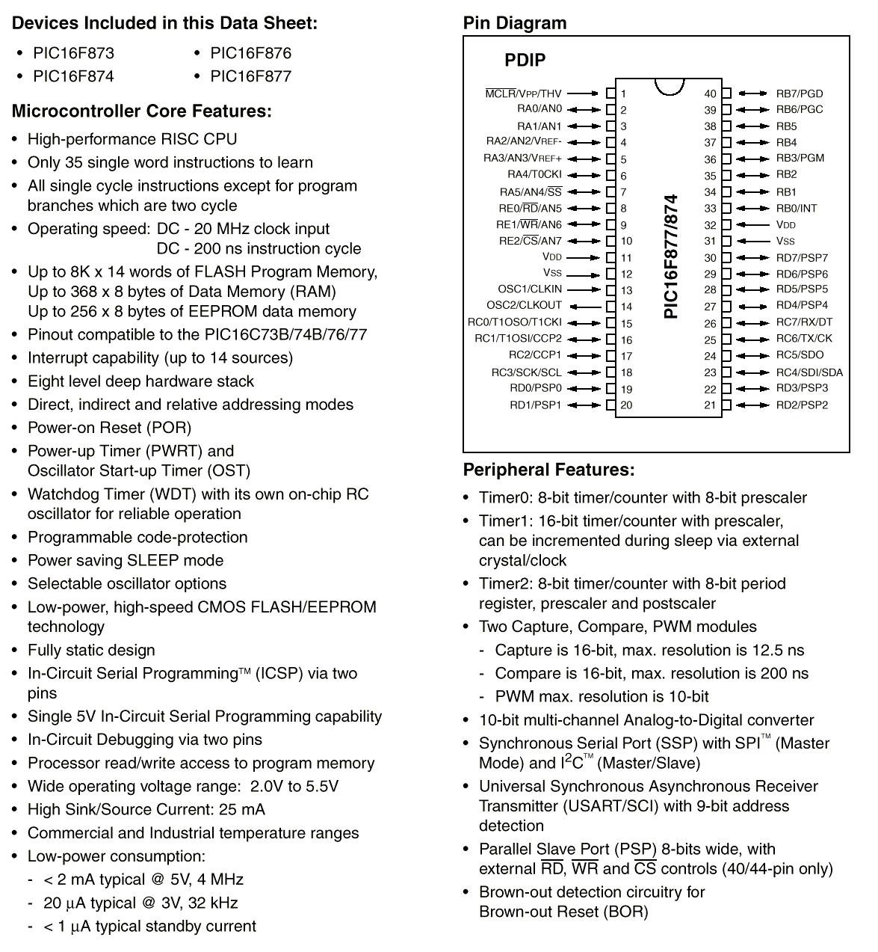
16F87x
Family:
Features

Slide 32
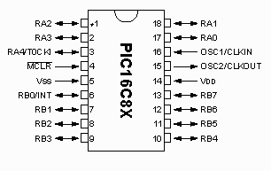
General Description/PIC16C84
18 pin microcontroller
1k of EEPROM program space
36 bytes of RAM
64 bytes of EEPROM Data
Timer
Watchdog timer
13 pins of I/O

Slide 33
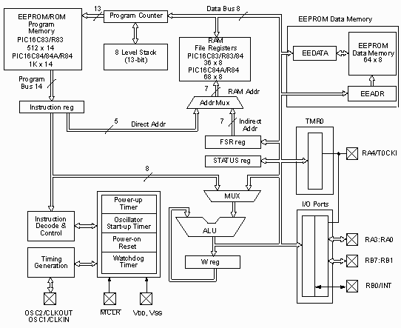

Slide 34
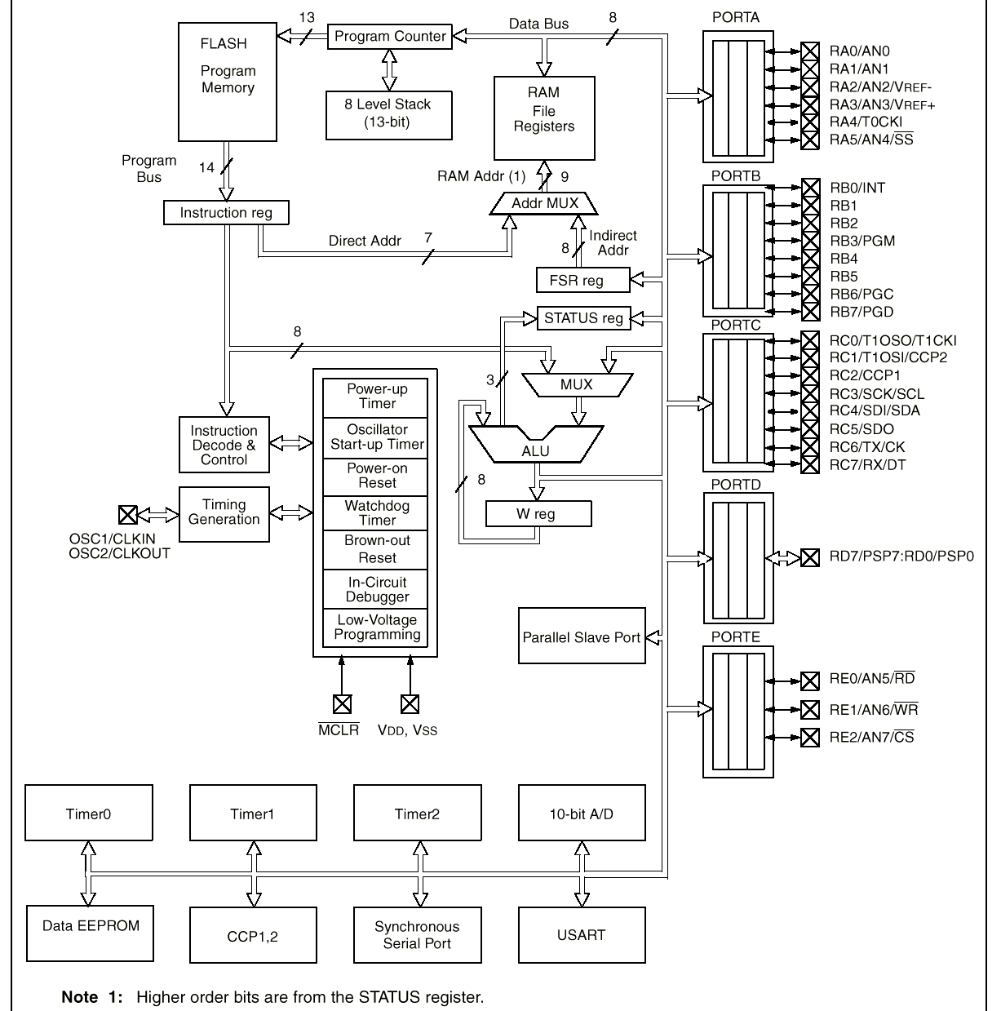
Typical Micro
Controller Elements
From:
PIC
16F87x
data
sheet
Notes:
Harvard architecture- separate instruction and data bus // 14 bit inst. Bus // 8 bit data and I/o
Pipelining -> most instruction execute in a single instruction cycle [4 clock cycles]

Slide 35
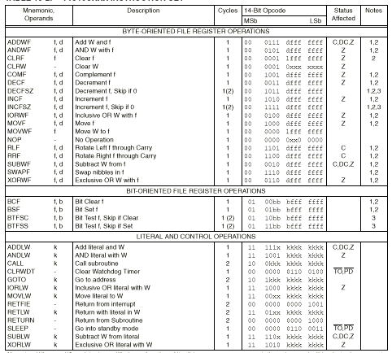
16F87x Instruction Set
[35]

Slide 36
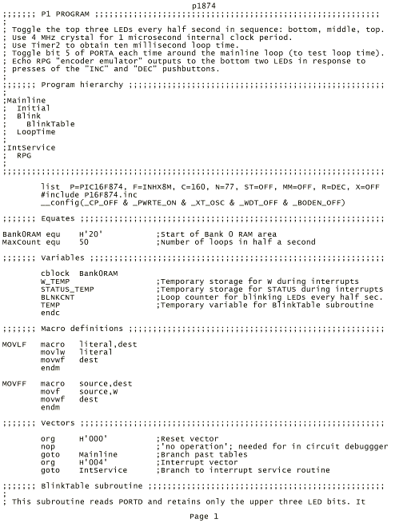
P1

Slide 37
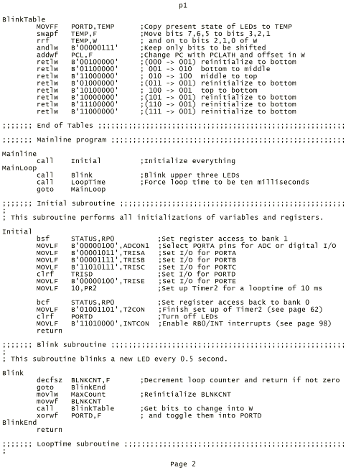
P1-2

Slide 38
Odd things to notice
Harvard architecture – separate busses
Program bus is 14 bits wide
  PIC16C8X series has a 14 bit wide instruction 'WORD'.
  CPU is still considered to be an 8-bit machine since the basic data size it deals with is 8 bits wide.
  16C5X series has a 12-bit instruction word
  17CXX series uses a 16-bit instruction word

Slide 39
Odd things to notice
“Registers”
  Only one working register: W register
  RAM on this chip is considered to be the File Registers. You get 36 bytes total.
  Other 'File' registers
    STATUS register
    FSR register
    Program Counter
  No stack register
    No data stack
    Call level stack holds 8 13-bit program counter values for storing return addresses.
    Limited call depth!

Slide 40
Tools
PICStart Plus programmer
  Handles programming most the DIP versions
  Comes with a development environment: MPLAB
    An IDE that includes an assembler, editor, simulator, and programmer software in one integrated package
  Write code, debug in the simulator, and program a chip from one program
  Available on the internet at http://www.microchip.com

Slide 41
Variations
Large number of variant chips
  Memory
  I/O pin count
  Serial Ports
  A/D
  I2C
  SPI
  etc.

Slide 42
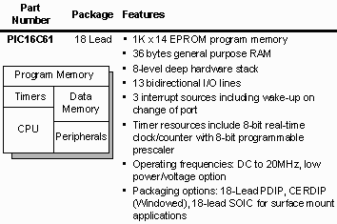
16C81
20mhz

Slide 43
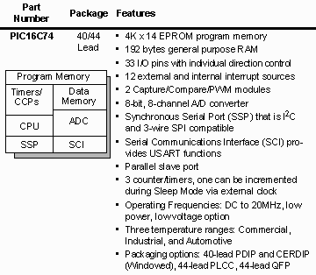
16C74
4k of onboard program memory
20Mhz
192 bytes of RAM
Available in UV
erasable

Slide 44
New Variations
About 1 a month
Examples:
  PIC12CXX: 8 pin device with 6 available I/O lines, and an onboard clock oscillator
  16 bit instruction core of the PIC17CXX series, allows for more code and data space.

Slide 45
Summary
PIC microcontrollers are very capable, small, fast, and readily available.
Useful for applications where a physically small part is needed
Not suited for some purposes, such as lots of text handling or pattern matching.
Appropriate for other applications, such as wheel encoding or dedicated subsystem work.

Slide 46
Credits and Copyrights
Diagrams contained in this lecture are from www.microchip.com
PIC is a registered trademark of Microchip Technology Incorporated in the U.S.A
Other information based on Dr. Martin Fox’s (U Conn) EE290/Intro to Microcontrollers presentation and on articles in HowThingsWork.com

